Slide 1




Business Revolution
Presented By:-
Solanki Kishan
RUDRA GOSWAMI COLLEGE OF
COMPUTER APPLICATION,AHEMDABAD
Chavda Pradip
INTERNAL GUIDE :-
MRs. MANISHA CHOUDHARY
Solanki Manish
EXTERNAL GUIDE :-
MR .HITESH KACHHELA

Slide 2
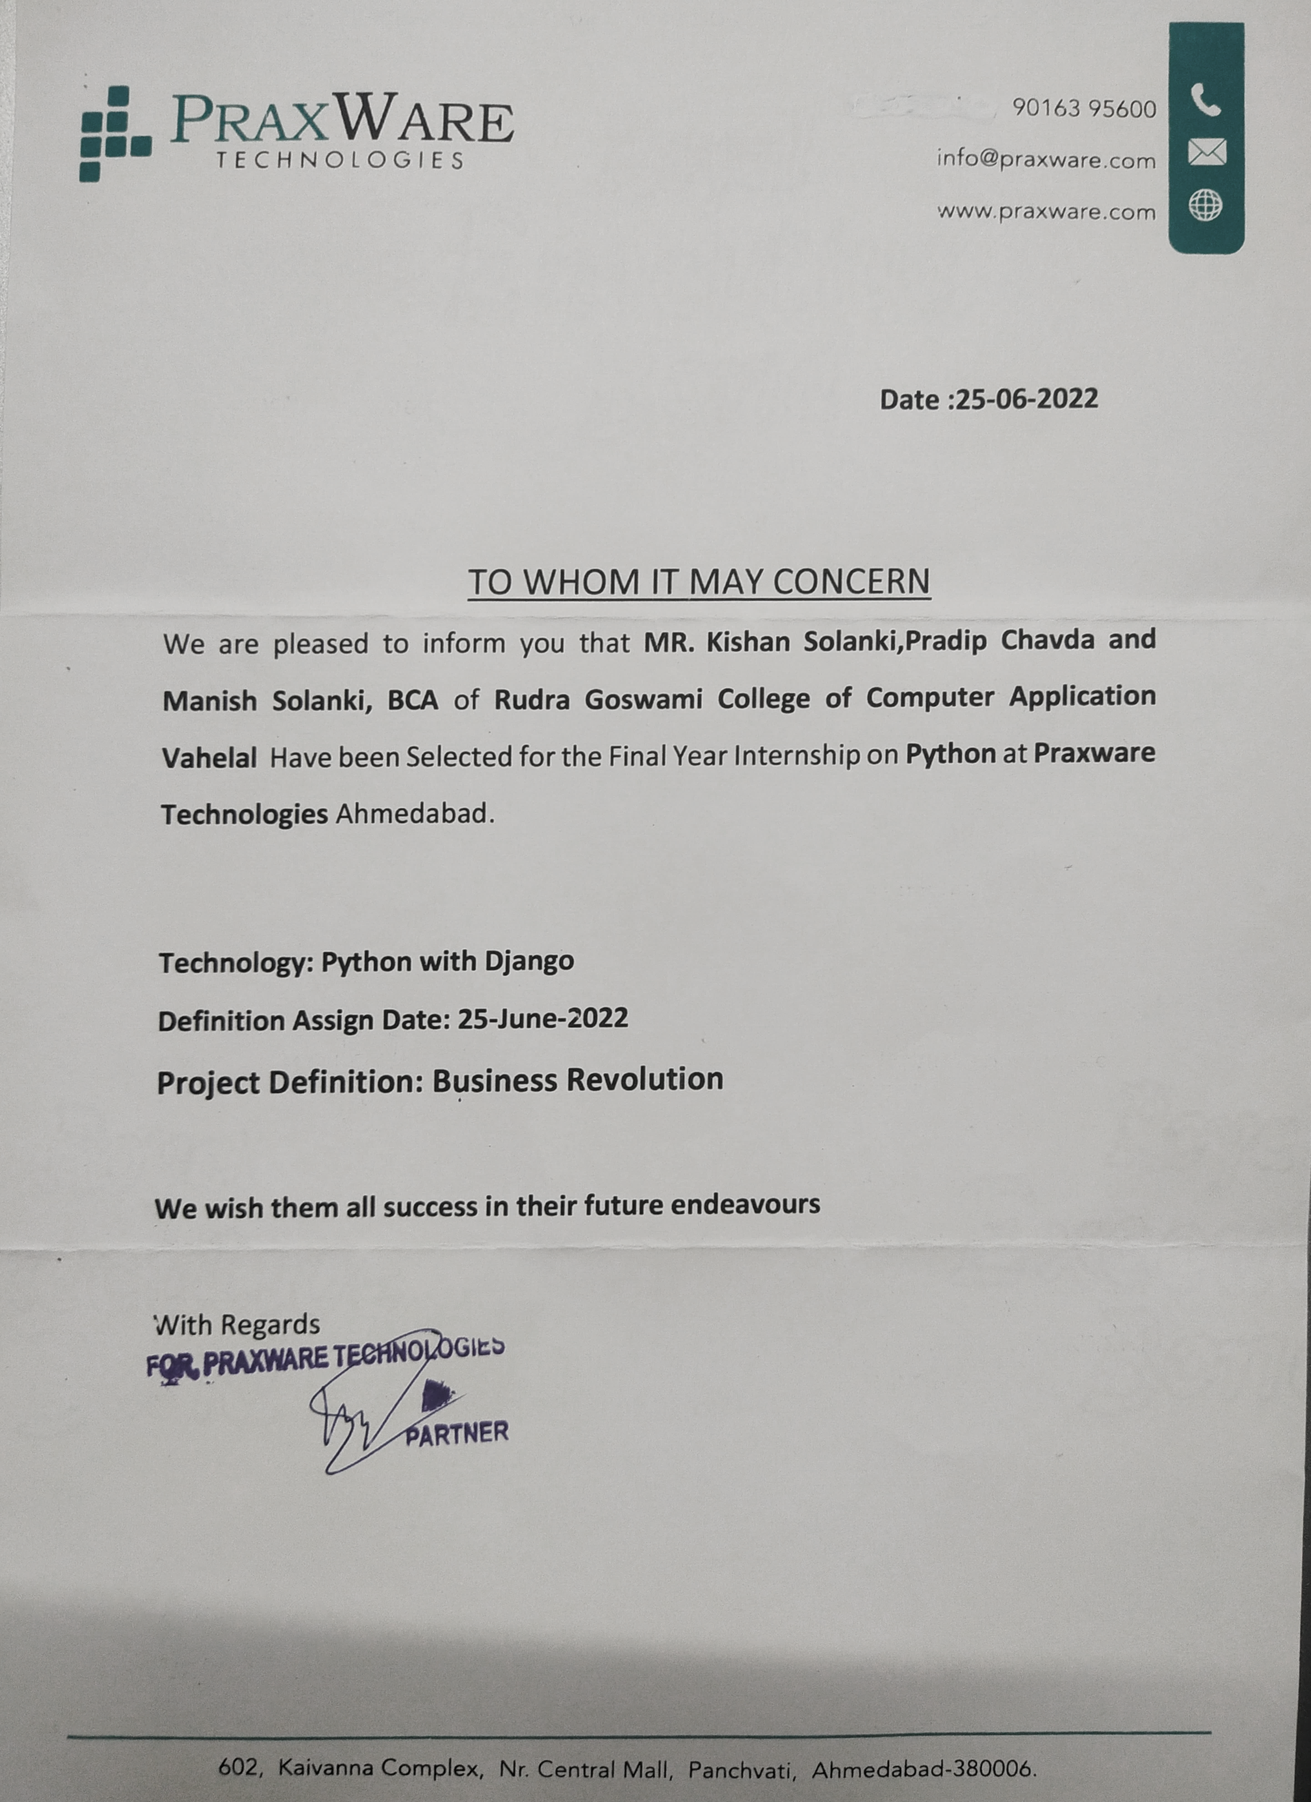
Company Certificate

Slide 3
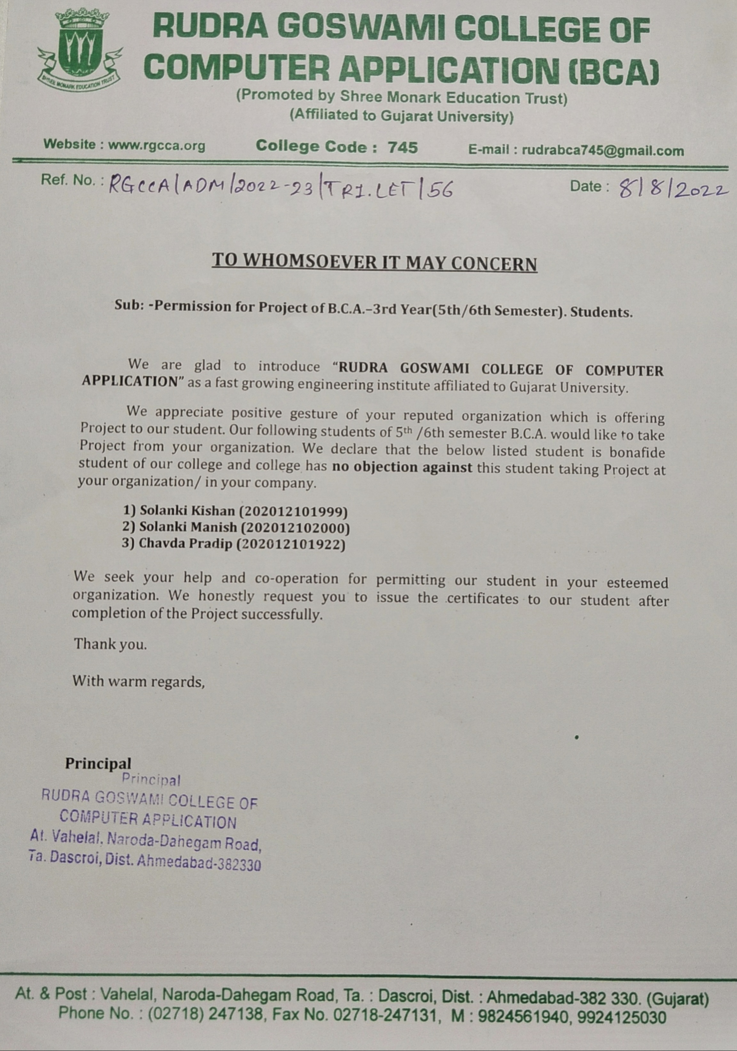
Collage Certificate

Slide 4
INDEX
Sr.No | TITLE | PAGE NO
1 | Project Profile | 05
2 | Company Profile | 06
3 | Existing System/Proposed System | 08
4 | Function Requirement specification | 11
5 | System Flow Diagram | 16
6 | Data Flow Diagram | 18
7 | Entity Relationship Diagram | 29
8 | Data Dictionary | 31

Slide 5
Project Profile | Project Profile
Project Title | BUSINESS REVOLUTION
Project category | WEB DEVLOPER
Objective | UPLOAD BUSINESS IDEAS AND ABOUT BUSINESS SUGGESTION
Front End | HTML / CSS / JAVASCRIPT / PYTHON
Back End | DJANGO / XAMPP
Tool | PYCHARM
Server | DJANGO
Documentation Tool | Draw.io
Internal Guide | Mrs. Manisha Choudhary
External Guide | Mr.Hitesh Kachhela
Developed By | [1] Solanki Kishan [2] Chavda Pradip [3] Solanki Manish
Group No | 6

Slide 6


Company Profile
Company Name : Praxware Technologies
Address : 602,kaivanna complex Nr.central mall, Ahmedabad,Gujarat 380006.
Email Address : info@praxware.com
External Guide : Hitesh Kachhela
Contact info : 9016395600

Slide 7

COMPANY ABOUT
Praxware Technologies, We have the most experienced and dedicated developers and programmers who are always in accord with fast growing technological orbit.
Our major objective is to provide state-of-art of products and innovative services in the field Information Technology.
We have designed and implemented a number of path breaking solutions that are user centric and target oriented.
We are always committed to establishing long-term relationship with our esteem Clients and Business Partners.
Compelled to have an in-depth understanding of our clients needs and concerns, we provide total Business Solutions with an uncompromising level of excellence and integrity

Slide 8
Existing system
Earlier, if the customer wanted some information about his startup business, then he had to go to different places and get information about all the businesses.
And sometimes the customer did not get complete information about the business.
And due to not getting complete information, many people used to lose money and time.
There were many people who had complete knowledge of business ideas but did not have a platform to present them.

Slide 9
Proposed system
When customers come to our website, they will get good ideas in low budget.
Customer will get ideas in different categories. We give full details of business ideas to a customer.
We give facility to a customer they can upload their own ideas and earn money.
In our website the customer have any problem then direct contact to the admin.

Slide 10

DEVLOPMENT TOOL
FRONT END : | HTML / CSS / JAVASCRIPT / PYTHON
BACK END : | DJANGO / XAMPP
TOOL : | PYCHARM, DJANGO SERVER
DOCUMENTATION TOOL : | DRAW.IO

Slide 11


FUNCTIONAL REQUIREMENT SPECIFICATION
USER SPECIFICATION MODULE
ADMIN
CUSTOMER
SELLER

Slide 12

User Specification Module
Admin
Seller
Customer

Slide 13
Admin
Manage Customer
Admin can Manage All types Customer
Manage Seller
Admin can Manage All types Seller
Manage Category
Admin can Manage All the types of Category
Manage Idea
Admin can Manage All the type of Idea
View Feedback
Admin can View All Feedback & Response
Manage Account
Admin manage Account
13

Slide 14
Seller
Add Idea
Seller can Add to All types Idea
Manage Account
Seller Edit Account
Manage Idea
Seller Edit Ideas
Payment Method
Seller Can Add Payment method type
Feedback
Seller can Add All Feedback
Report
Seller Can Add Report problem
14

Slide 15
Customer
Search Idea
Customer Search your Idea
Search Category
Customer Search Your Category
Payment
Customer Pay To Your Idea
Add To Favourite
Customer Your Save To Idea
Feedback
Customer can Add All Feedback
Report
Customer Can Add Report problem
15

Slide 16

1.
SYSTEM FLOW DIAGRAM

Slide 17
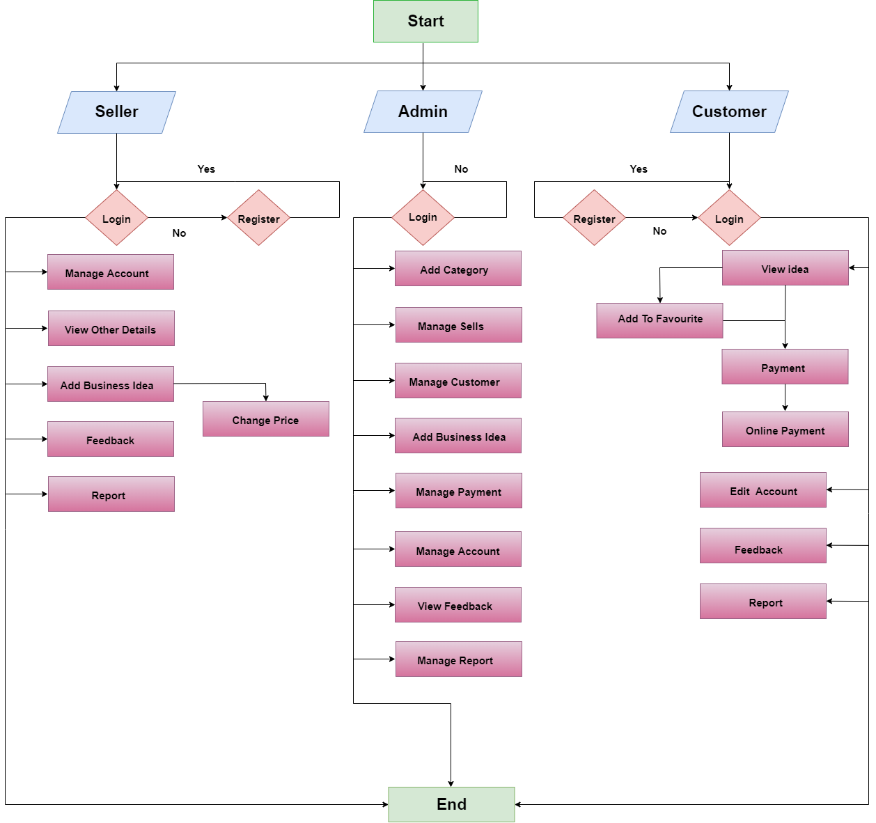

Slide 18


2. DATA FLOW DIAGRAM
0 Leval DFD (Data Flow Diagram)
Admin 1 Leval DFD (Data Flow Diagram)
Seller 1 Level DFD (Data Flow Diagram)
Customer 1 Leval DFD (Data Flow Diagram)
Admin 2 Leval DFD (2.0:Category) (Data Flow Diagram)
Admin 2 Leval DFD (3.0:Sub Category) (Data Flow Diagram)
Seller 2 Leval DFD (3.0:Account) (Data Flow Diagram)
Seller 2 Leval DFD (4.0:Upload idea) (Data Flow Diagram)
Customer 2 Leval DFD (5.0:Account) (Data Flow Diagram)
Customer 2 Leval DFD (7.0:Payment) (Data Flow Diagram)

Slide 19
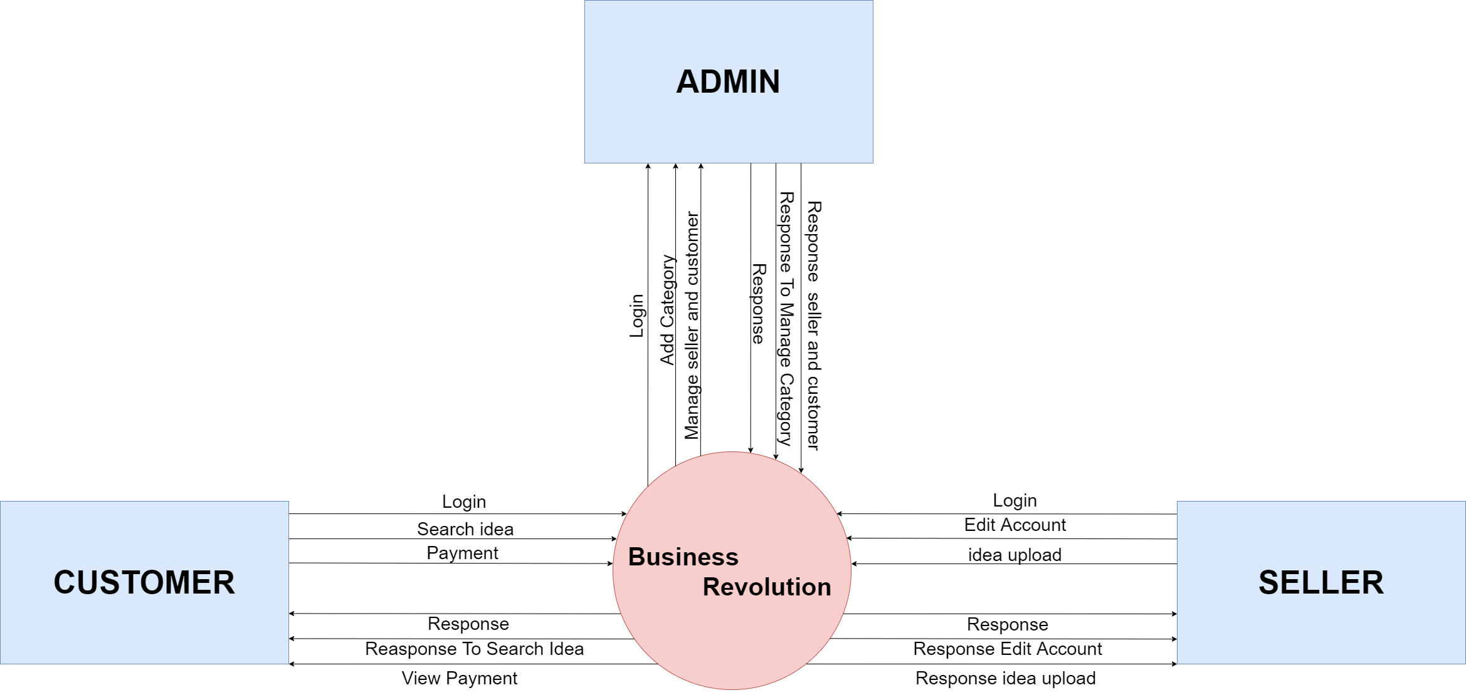
0 Leval DFD (Data-Folw Diagram)

Slide 20
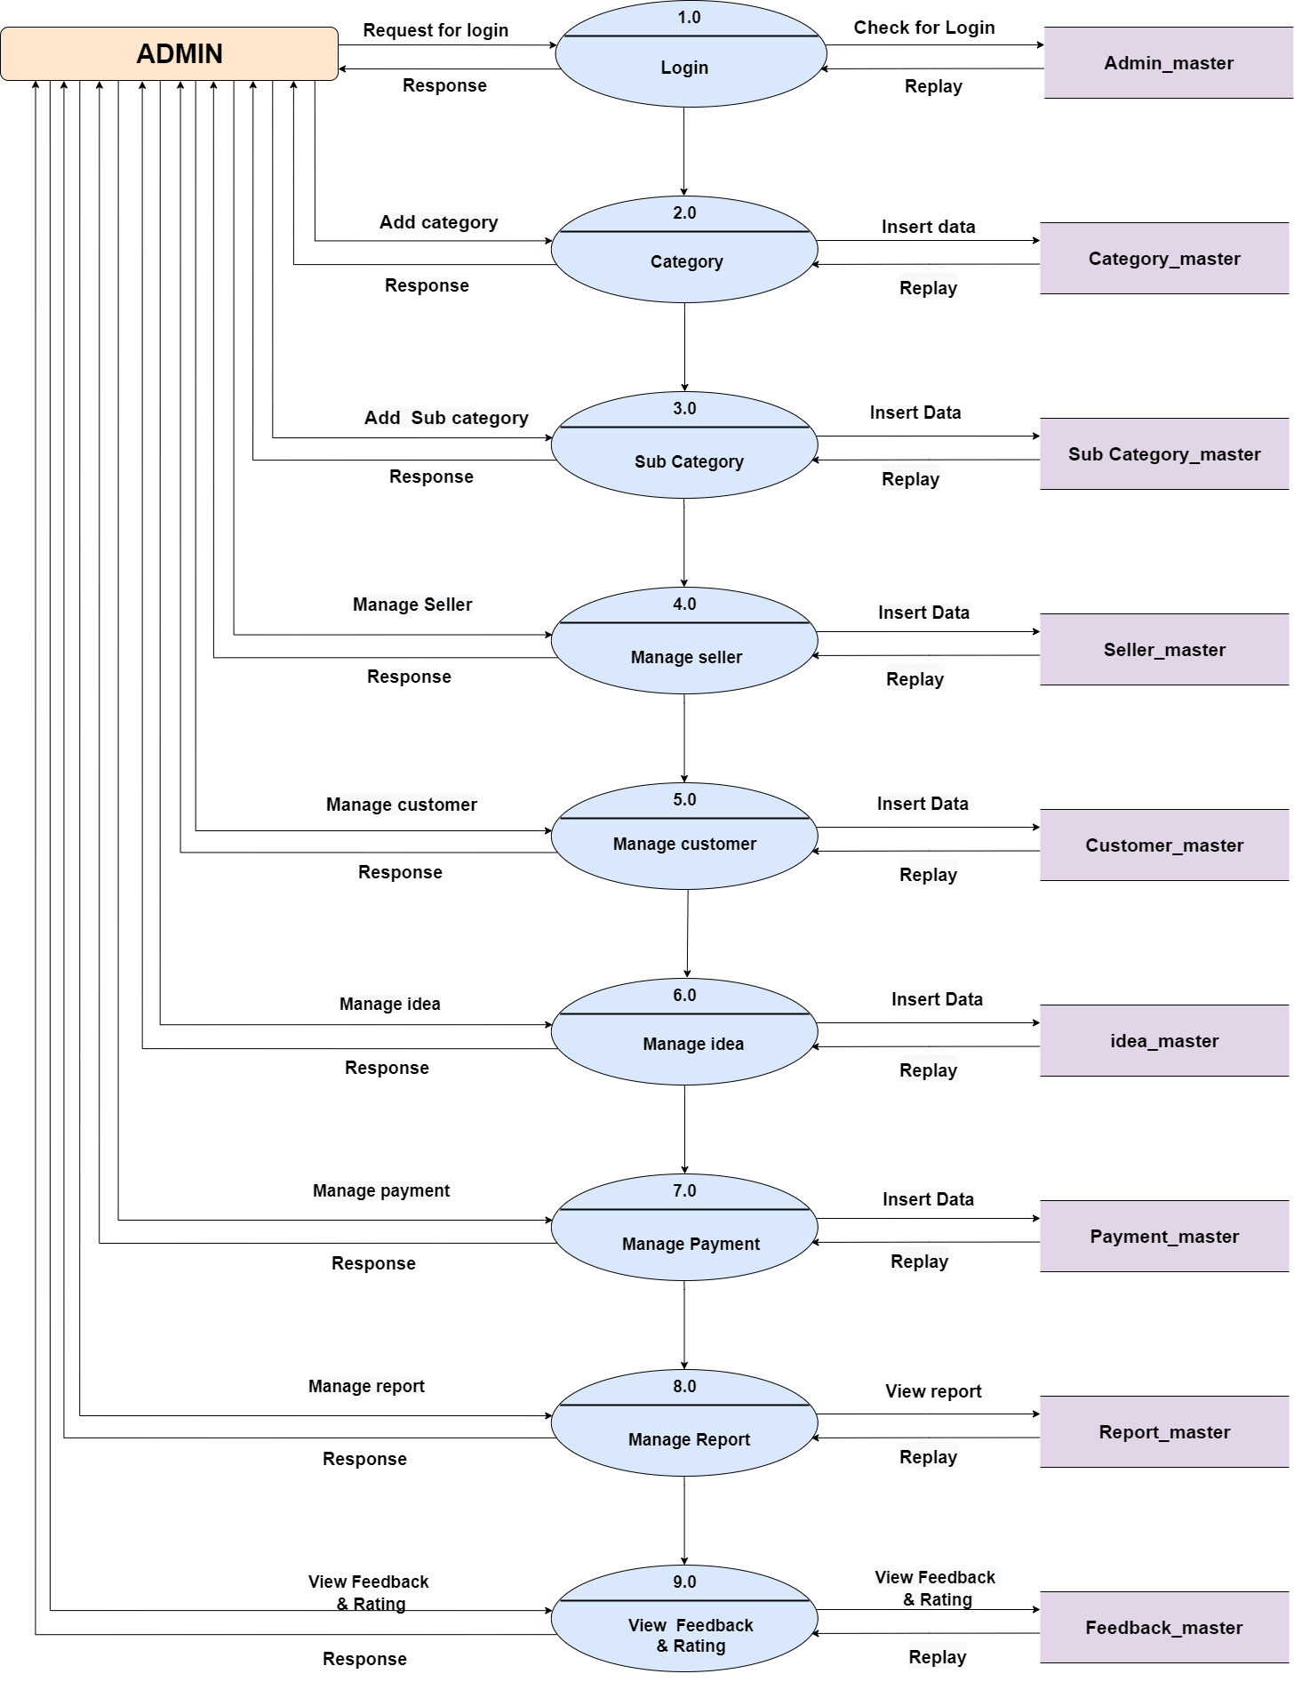
Admin 1 Leval DFD (Data Flow Diagram)

Slide 21
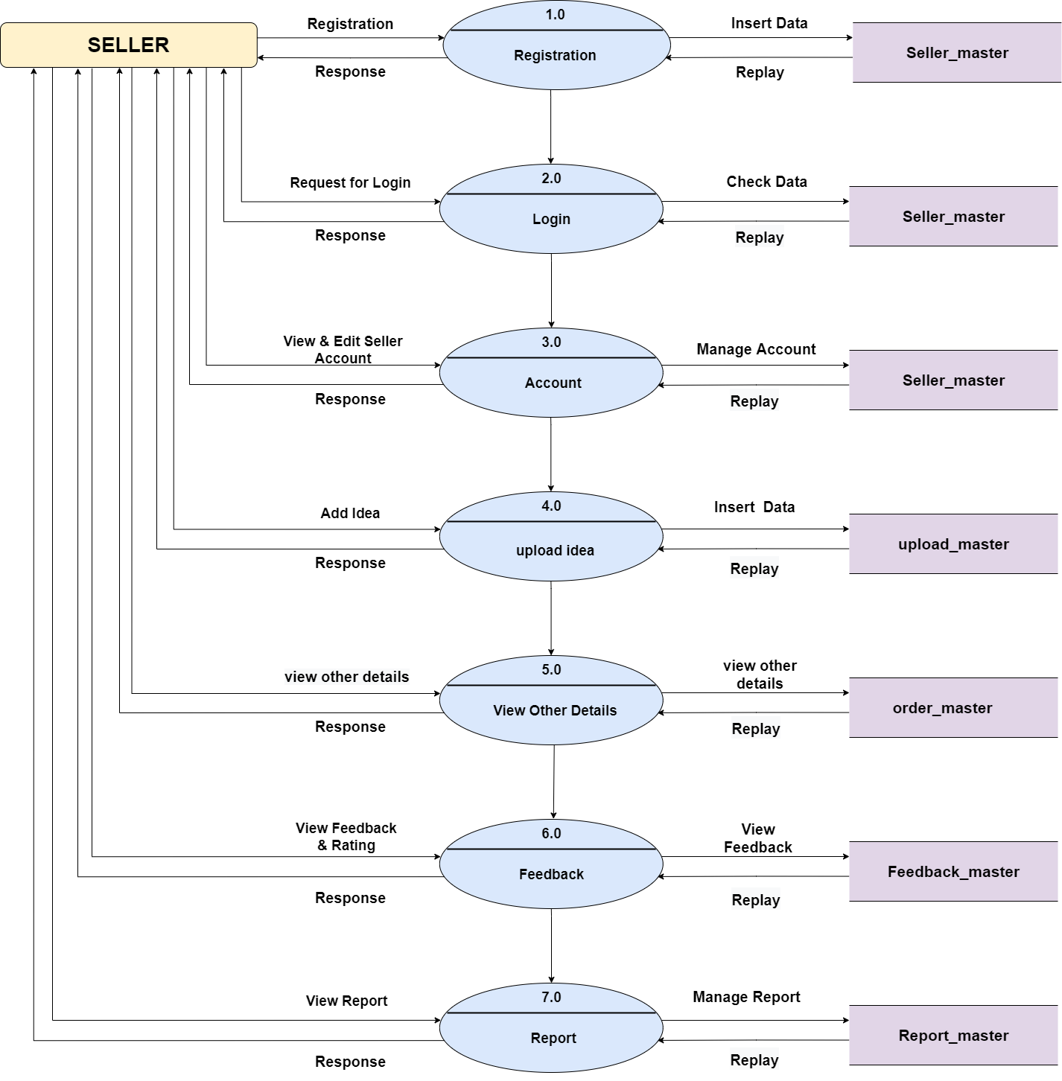
Seller 1 Level DFD (Data Flow Diagram)

Slide 22
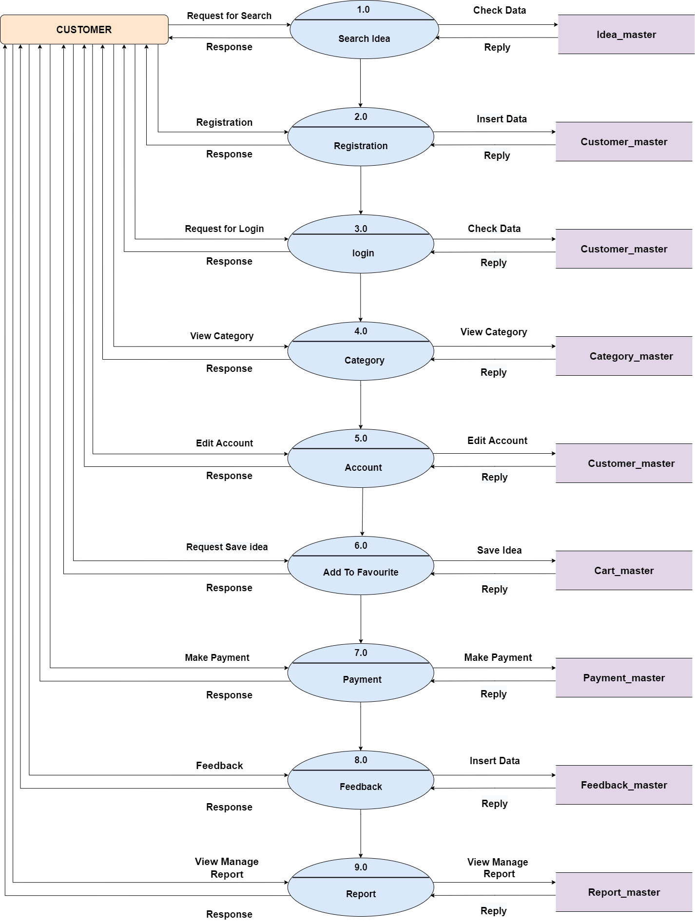
Customer 1 Leval DFD (Data Flow Diagram)

Slide 23
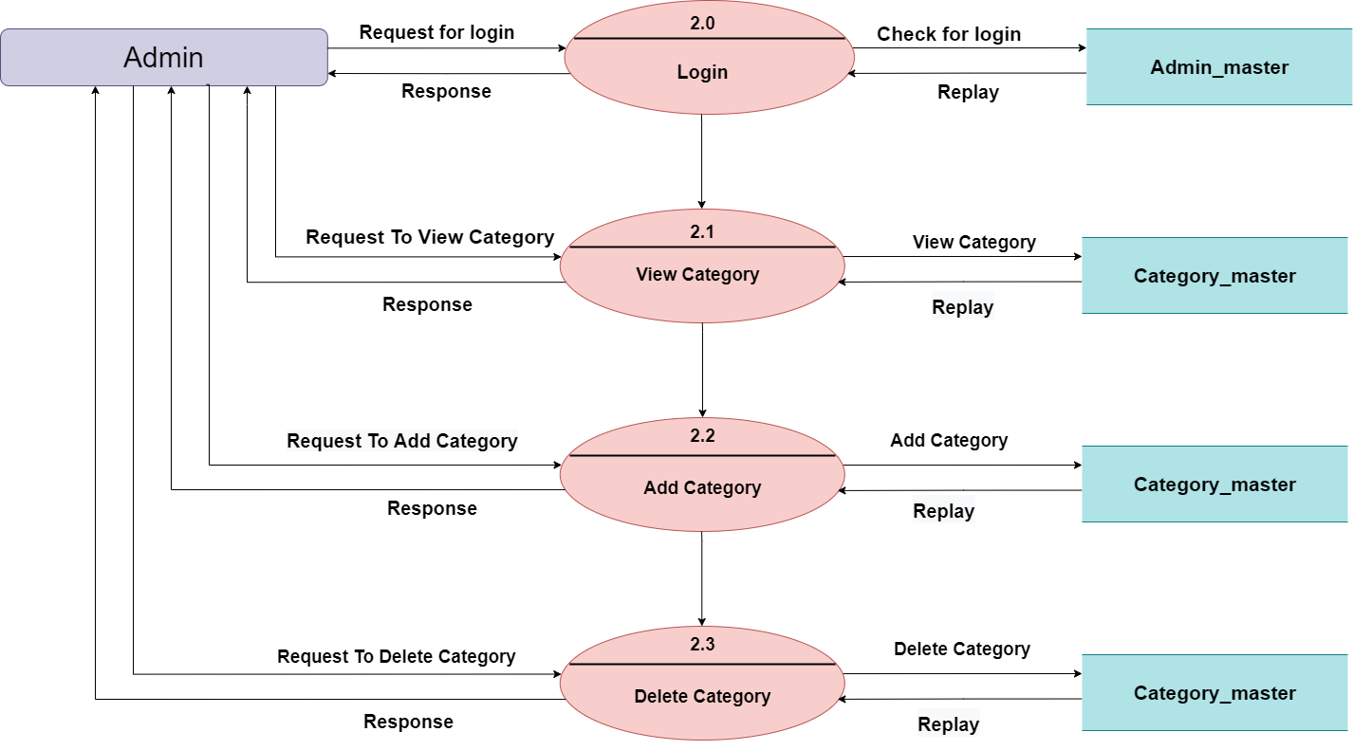
Admin 2 Leval DFD (2.0 : Category) (Data Flow Diagram)

Slide 24
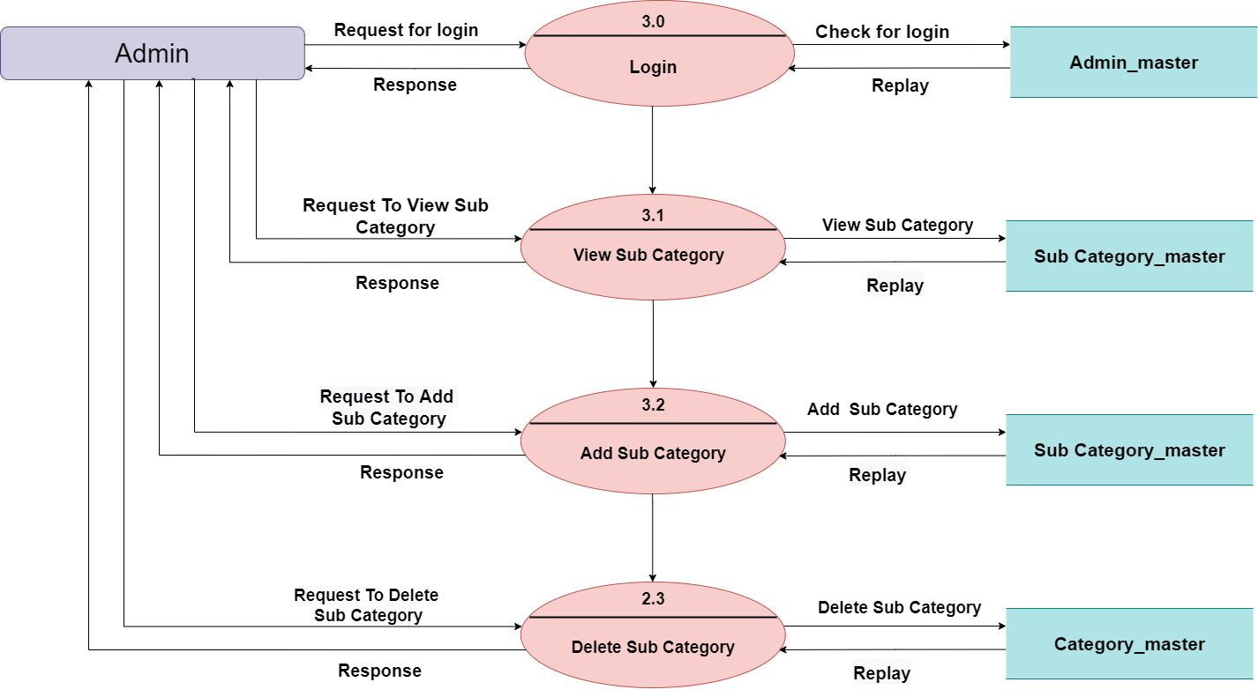
Admin 2 Leval DFD (3.0: Sub Category) (Data Flow Diagram)

Slide 25
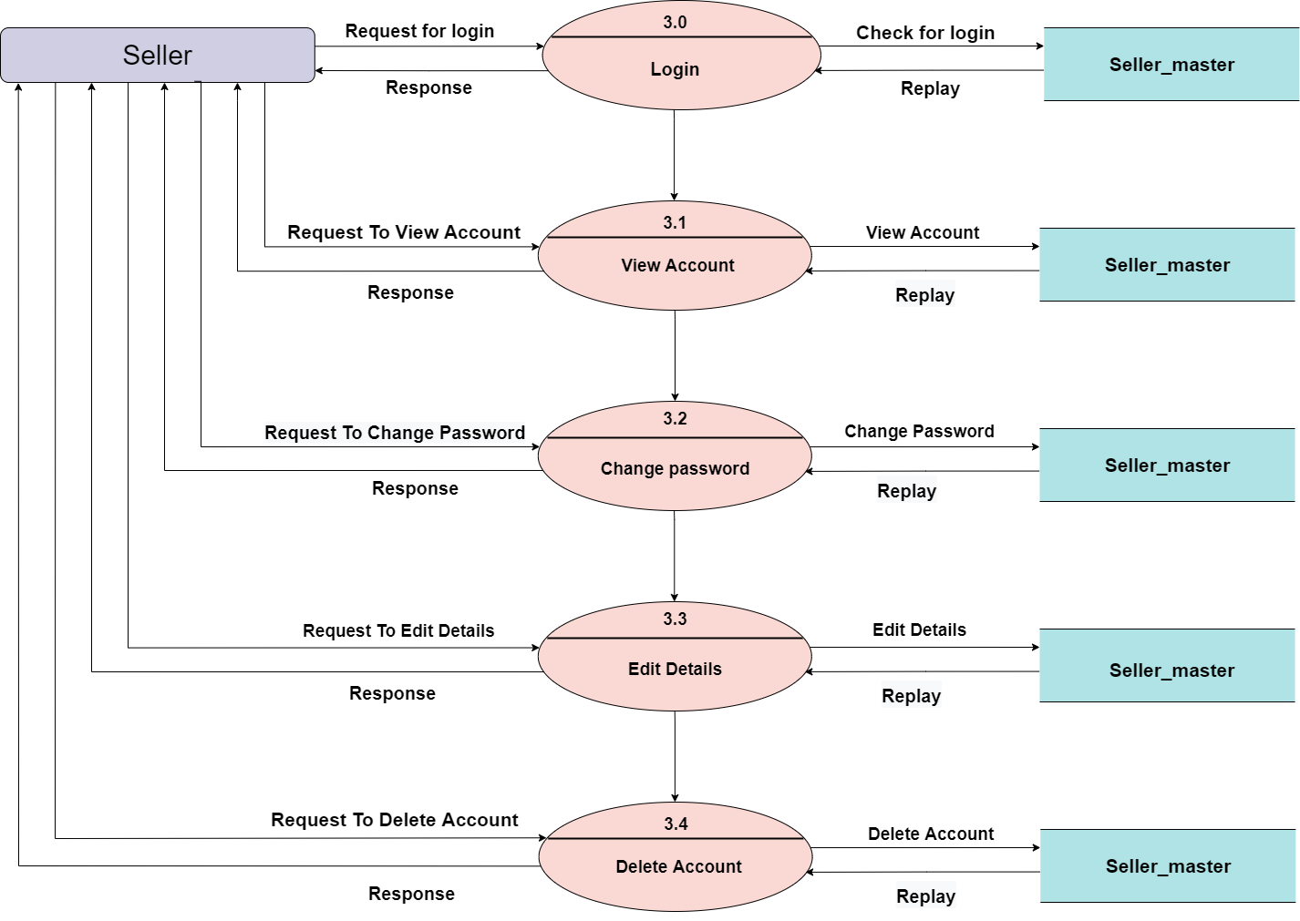
Seller 2 Leval DFD (3.0: Account) (Data Flow Diagram)

Slide 26
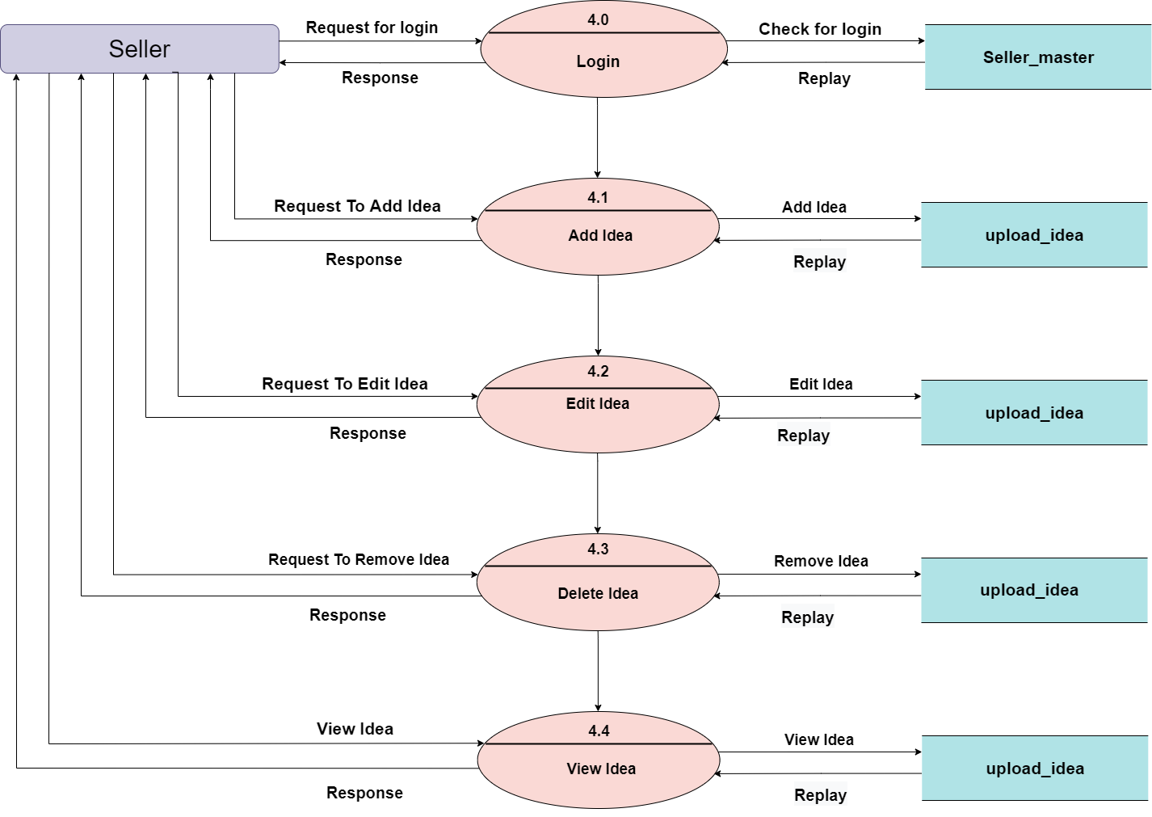
Seller 2 Leval DFD (4.0: Upload Idea) (Data Flow Diagram)

Slide 27

Customer 2 Leval DFD (5.0:Account) (Data Flow Diagram)

Slide 28
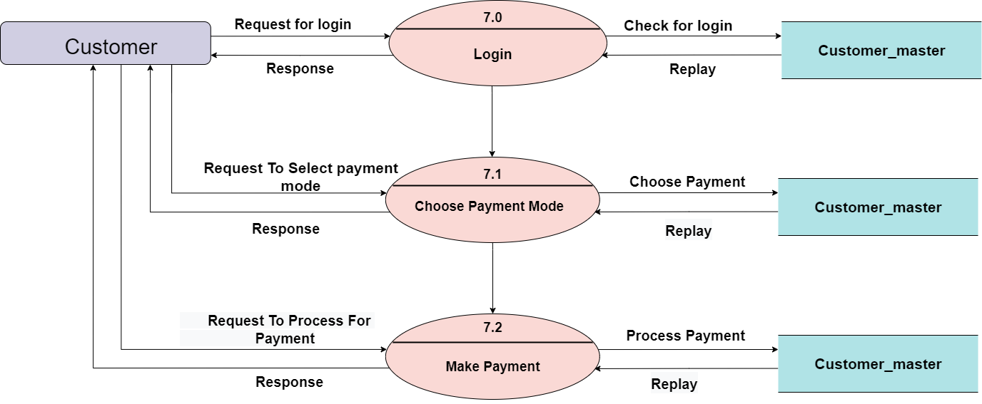
Customer 2 Leval DFD (7.0: Payment) (Data Flow Diagram)

Slide 29

3
Entity Relationship Diagram

Slide 30
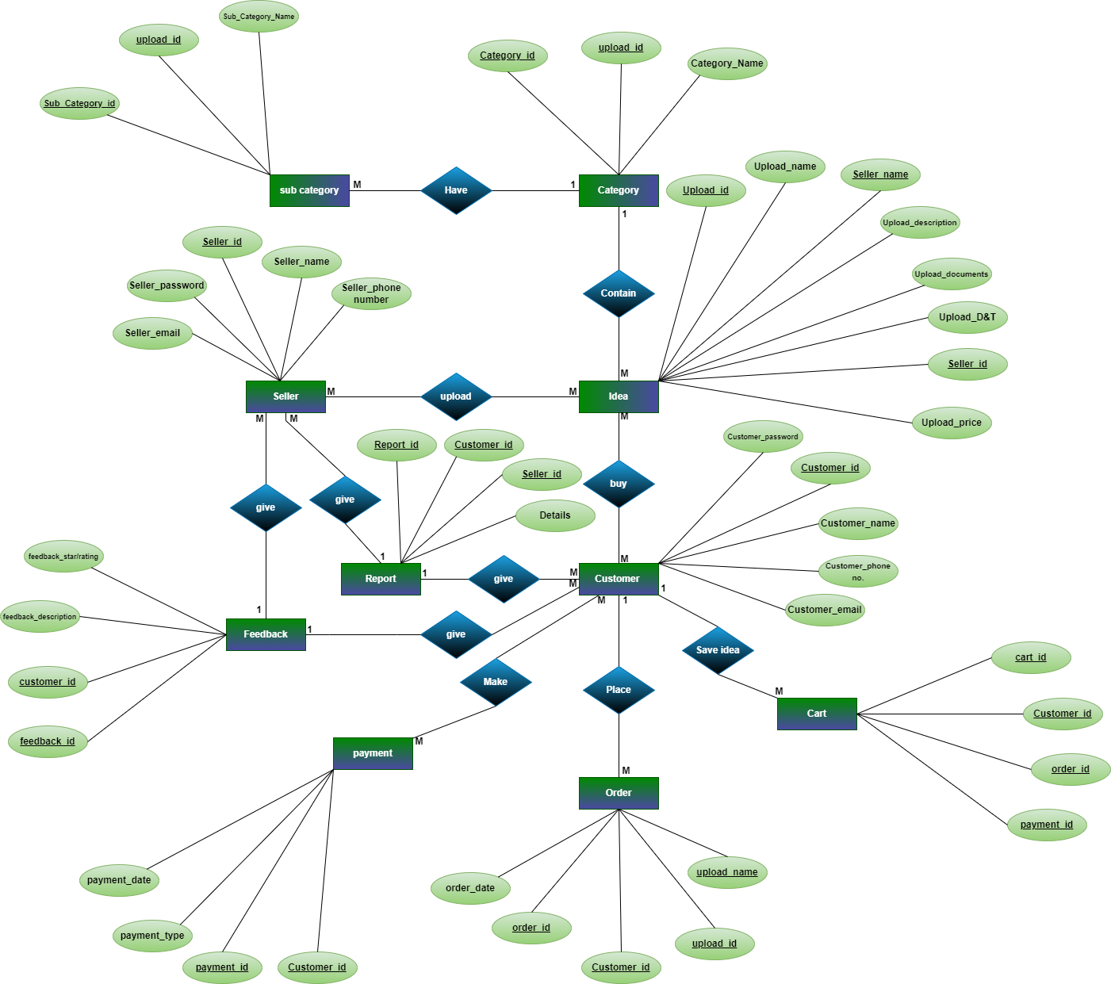
Entity
Relationship
Diagram

Slide 31

4
DATA DICTIONARY

Slide 32
1 ADMIN TABLE
Primary Key :- Admin_id
Table Description :- Represents Admin details
Field_name | Data_type | Size | Constraint | Description
admin_id | int | 11 | Primary key | this should be unique id
admin_name | varchar | 50 | Not null | admin name
admin_email | varchar | 50 | Not null | admin email
admin_password | varchar | 50 | Not null | admin password

Slide 33
2 Seller TABLE
Primary Key :- seller_id
Table Description :- Seller Details Table
Field_name | Data_type | Size | Constraint | Description
Seller_id | int | 11 | primary key | this should be unique id
Seller_name | varchar | 50 | not null | seller name
Seller_ Phone Number | int | 11 | not null | seller name
Seller_email | varchar | 50 | not null | seller email
Seller_password | varchar | 20 | not null | seller password

Slide 34
3 Customer TABLE
Primary Key :- Customer_id
Table Description :- Customer Details Table
Field_name | Data_type | Size | Constraint | Description
Customer_id | integer | 11 | primary key | this should be unique id
Customer_name | string | 50 | not null | Customer name
Customer_phone no. | integer | 11 | not null | Customer number
Customer_email | varchar | 50 | not null | Customer email
Customer_password | varchar | 50 | not null | Customer password

Slide 35
4 UPLOAD_IDEA Table
Primary Key :-upload_id
Foreign Key :- Seller_id / category_id
Table Description :- About Product Details Table
Field_name | Data_type | Size | Constraint | Description
Upload_id | int | 11 | primary key | this should be unique id
Upload_name | varchar | 100 | not null | upload idea name
Upload_description | varchar | 500 | not null | upload Idea's description
Upload_documents | varchar | 500 | not null | upload Idea's documents
Upload_D&T | int | Date/Time | not null | upload Idea's date & time
Upload_price | int | 4 | not null | upload Idea's price
Seller_id | int | 11 | foreign key | seller id
Category_id | int | 11 | foreign key | Foreign key category id

Slide 36
5 Category Table
Primary Key :- category_id
Table Description :- Category Details Table
Field_name | Data_type | Size | Constraint | Description
Category_id | int | 11 | primary key | this should be unique id
Category_Name | varchar | 50 | not null | Category Name
upload_id | int | 11 | foreign key | this should be unique id

Slide 37
6 Sub Category Table
Primary Key :- subcategory_id
Foreign Key :- category_id
Table Description :- Sub-Category Details Table
Field_name | Data_type | Size | Constraint | Description
Sub_Category_id | int | 11 | primary key | this should be unique id
Sub_Category_Name | varchar | 50 | not null | Category Name
upload_id | int | 11 | foreign key | this should be unique id

Slide 38
7 Order Table
Primary Key :-order_id
Foreign Key :- Customer_id / upload_id / upload name
Table Description :- About Order Details Table
Field_name | Data_type | Size | Constraint | Description
order_id | int | 11 | primary key | this should be unique id
order_date | int | Date/Time | not null | Purchase date
Customer_id | int | 11 | foreign key | customer all details
upload_id | int | 11 | foreign key | upload id
upload name | Varchar | 50 | foreign key | upload idea name

Slide 39
8 cart Table
Primary Key :-cart_id
Foreign Key :- customer_id / order_id / payment_id
Table Description :- About Cart Details Table
Field_name | Data_type | Size | Constraint | Description
cart_id | int | 11 | primary key | this should be unique id
Customer_id | int | 11 | foreign key | Customer_id
order_id | int | 11 | foreign key | order_id
payment_id | bigint | 11 | foreign key | payment_id

Slide 40
9 Payment Table
Primary Key :-payment_id
Foreign Key :- customer_id / order_id
Table Description :- About Payment Details Table
Field_name | Data_type | Size | Constraint | Description
payment_id | integer | bigint(11) | primary key | this should be unique id
payment_date | date | Date/Time | not null | payment date
payment_method | varchar | bigint(15) | not null | COD,debit card ,credit card, net banking
Customer_id | integer | bigint(11) | foreign key | Customer id
payment_status | varchar | 255 | Not null | Status of payment
Order_id | integer | bigint(11) | foreign key | foreign id

Slide 41
10 Feedback Table
Primary Key :-feedback_id
Foreign Key :- customer_id
Table Description :- About Feedback Details Table
Field_name | Data_type | Size | Constraint | Description
feedback_id | integer | bigint(11) | primary key | this should be unique id
feedback_description | varchar | 200 | not null | feedback description
customer_id | integer | bigint(11) | foreign key | buyer id
Feedback_rating | integer | 5 | null | feedback rating

Slide 42
11 REport Table
Primary Key :-report_id
Foreign Key :- customer_id / seller_id
Table Description :- About Complaint Details Table
Field_name | Data_type | Size | Constraint | Description
report_id | int | 11 | primary key | this should be unique id
Customer_id | int | 11 | foreign key | Customer_id
Seller_id | int | 11 | foreign key | Seller_id
Details | varchar | 200 | not null | Details About Report

Slide 43


